Slide 1
Theory of Automata
Lecture # 12
Imtiaz Ahmed
Finite Automata with Output

Slide 2
Finite Automata With Output
Finite automaton discussed so far, is just associated with the RE or the language.
There is a question whether does there exist an FA which generates an output string corresponding to each input string ?
The answer is yes. Such machines are called machines with output.
There are two types of machines with output. Moore machine and Mealy machine

Slide 3
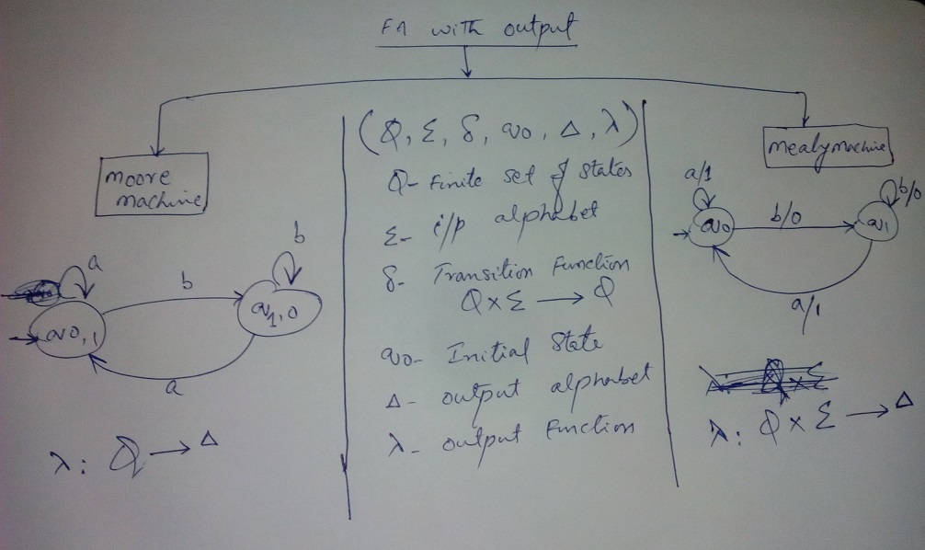
Formal Definition & Difference between Moore and Mealy Machines

Slide 4
Formal Definition of Moore Machine
A Moore machine consists of the following
A finite set of states Q0, Q1, Q2, … where Q0 is the initial state.
An alphabet of letters Σ = {a,b,c,…} from which the input strings are formed.
A transition Function that shows for each state and each input letter what state is entered the next.
Q0 – Initial State
An alphabet of possible output characters ={x,y,z,…} from which output strings are generated.
ʎ - Output Function.

Slide 5
Moore Machine (Contd..)
It is to be noted that since in Moore machine no state is designated to be a final state, so there is no question of accepting any language by Moore machine.
However in some cases the relation between an input string and the corresponding output string may be identified by the Moore machine.

Slide 6
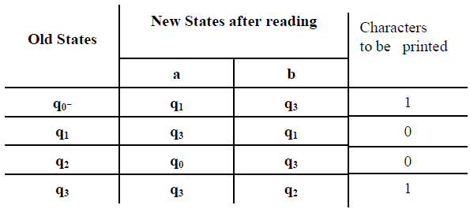
Moore Machine (Example-1)
Consider the following Moore machine having the states q0, q1, q2, q3 where q0 is the start state and Σ = {a,b}, Γ={0,1}
Transition Table

Slide 7
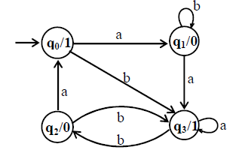
Moore Machine (Example-1 Contd..)
The Transition Diagram / State Diagram corresponding to the previous transition table may be
Running the string abbabbba over the above machine, the corresponding output string will be 100010101

Slide 8
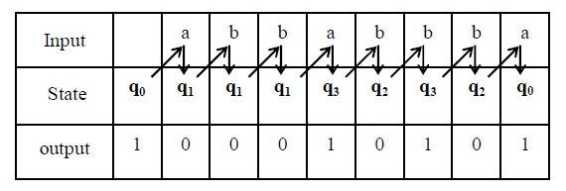
Moore Machine (Example-1 Contd..)
Output string is l more than that of input string as the initial state prints out the extra character 1, before the input string is read.

Slide 9
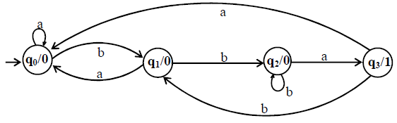
Moore Machine (Example-2)
Consider the following Moore Machine having the states q0, q1, q2, q3 where q0 is the start state and Σ = {a,b}, ={0,1}
If the string bbbabaabbaa is run on above Moore Machine, What will be the output string?

Slide 10
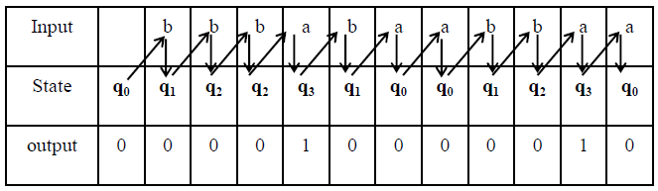
Moore Machine (Example-2 Contd..)

Slide 11
Moore Machine (Example-2 Contd..)
It can be observed from the given Moore machine that q3 is the only state which prints out the character 1 which shows that the moment the state q3 is entered, the machine will print out 1.
It can also be observed that to enter the state q3, string must contain substring bba.
In general the input string will visit the state q3 as many times as the number of substring bba occurs in the input string.
Thus the number of 1’s in an output string will be same as the number of substring bba occurs in the corresponding input string.

Slide 12

Thanks!

